Slide 1

Part 1: Device Integration with Wokwi and Node-RED

Slide 2
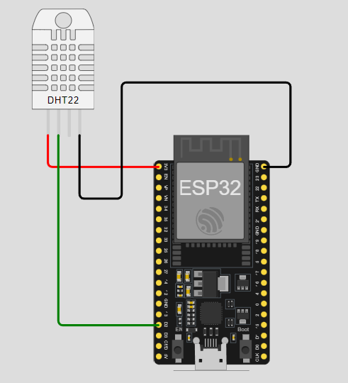
Wiring Diagram

Slide 3
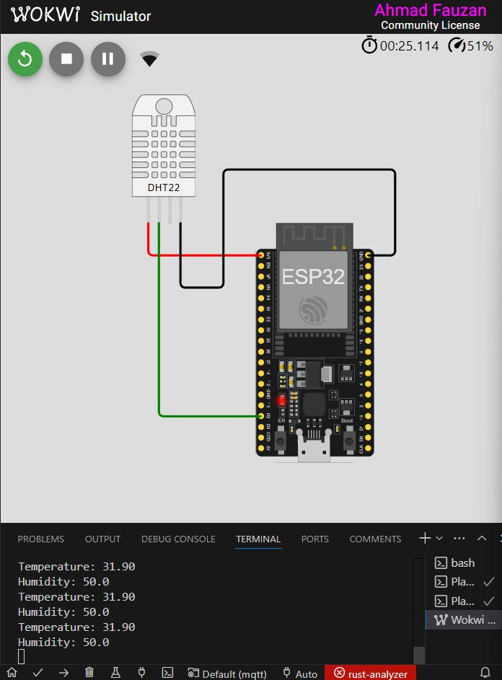
Testing the Temperature Sensor with library

Slide 4
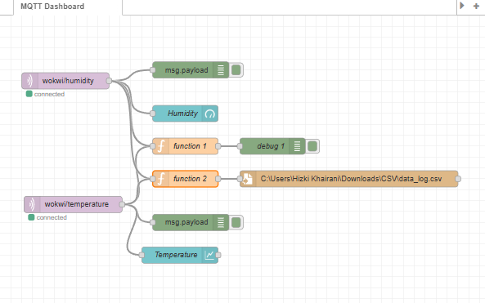
Node Red Flow with json output and csv data log

Slide 5
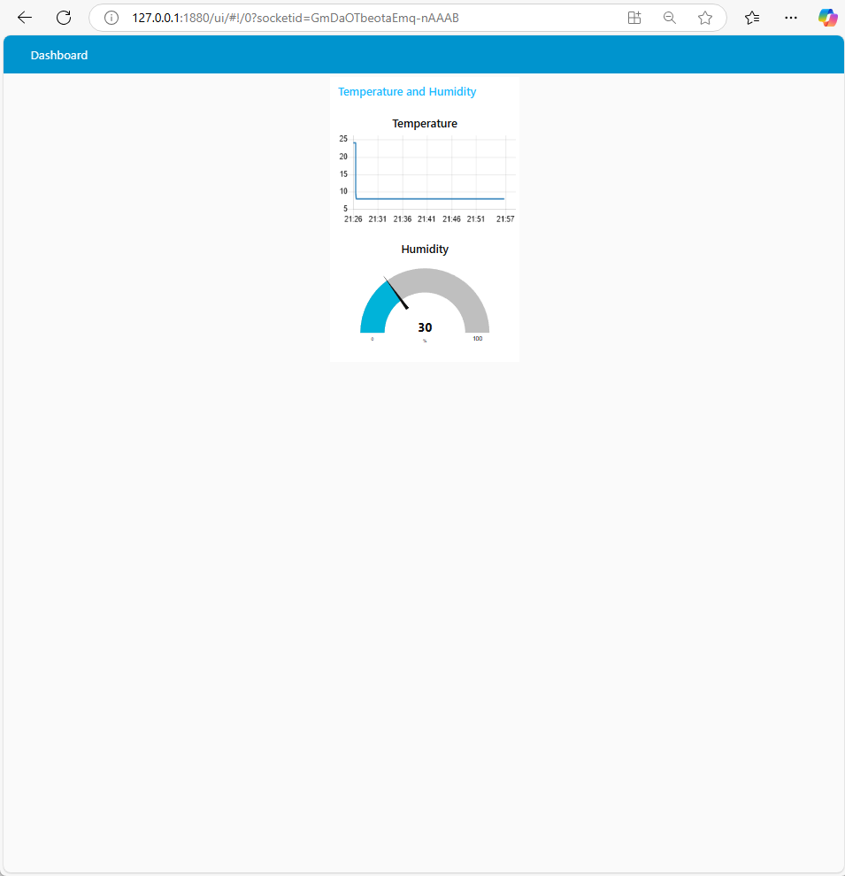
Monitoring Dashboard Integration

Slide 6

Thank you
Brita Tamm
502-555-0152
brita@firstupconsultants.com
www.firstupconsultants.com

